Slide 1

Deep Learning
Presented by – Sameer (B.Sc. Data Science, Sem 5)
Presented to –
Dr Aashima Bangia

Slide 2
Introduction
Deep learning is a subset of machine learning, emulating the human brain through artificial neural networks. It excels at feature extraction and complex pattern recognition, making it a game-changer in various domains.

Slide 3
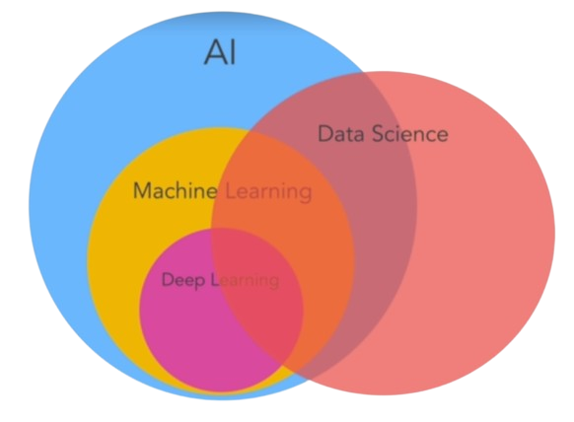
Key Components of Deep Learning
Neural networks, the backbone of deep learning, consist of layers of interconnected nodes. We use activation functions, loss functions, and optimizers to train these networks, enabling them to learn from data.

Slide 4
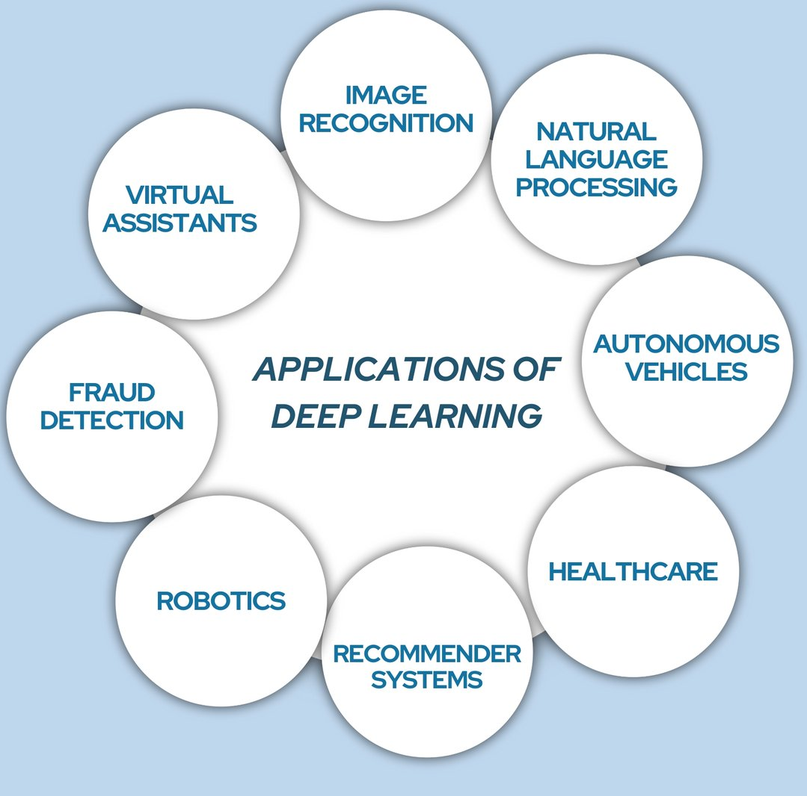
Applications of Deep Learning
From image and speech recognition to natural language processing, deep learning finds applications in diverse fields like healthcare, finance, and autonomous vehicles, revolutionizing how we solve complex problems.

Slide 5
Deep Learning Libraries - TensorFlow, and PyTorch
Python, a versatile programming language, serves as the foundation for deep learning. TensorFlow and PyTorch, two prominent libraries, offer high-level abstractions and tools, simplifying the implementation of complex neural networks.

Slide 6

Introduction to TensorFlow
Developed by Google Brain, TensorFlow is an open-source deep learning library. Its comprehensive ecosystem, including TensorFlow Lite and TensorFlow.js, facilitates deployment on diverse platforms.

Slide 7
Using TensorFlow for Deep Learning
TensorFlow provides a high-level Keras API, simplifying model building. With eager execution and Tensor Board for visualization, it offers a robust environment for developing and training deep neural networks.

Slide 8
Example Project - Emotion Detection

Slide 9
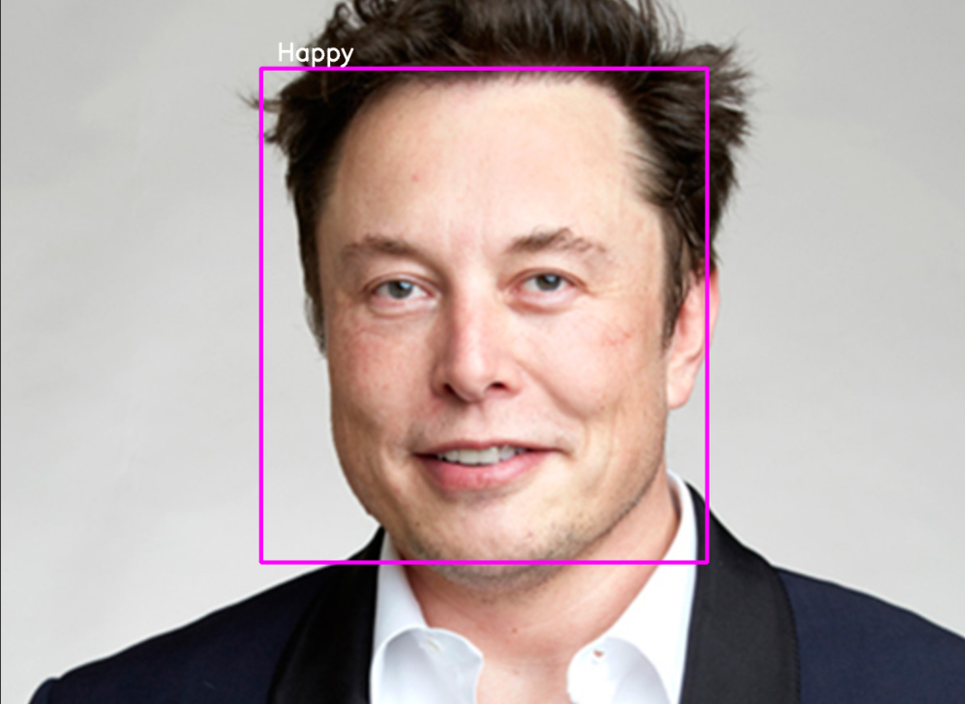
Emotion Detection
Let's delve into a practical example: emotion detection using deep learning. This project involves training a neural network to recognize facial expressions, providing valuable insights into human emotions.
Project link - Link

Slide 10
Project Workflow
Data Collection: Gather a dataset of facial expressions, labelling each image with the corresponding emotion.
Data Preprocessing: Crop and resize images, ensuring uniformity. Normalize pixel values for efficient model training.
Model Architecture: Use Haar Cascade to build a model using TensorFlow's Keras API for image-based tasks.

Slide 11
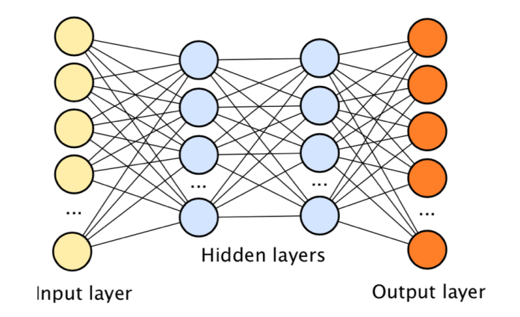
Model Training
Utilize TensorFlow's powerful tools to train the model on the pre-processed dataset. Fine-tune hyperparameters and monitor performance using validation data.

Slide 12
Conclusion
Deep learning, driven by libraries like TensorFlow and PyTorch, continues to reshape industries. Embracing these tools enables us to solve intricate problems and unlock new possibilities, making strides toward a future where intelligent systems are ubiquitous.

Slide 13
THANK YOU

